Slide 4
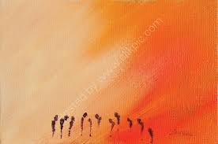

Slide 6
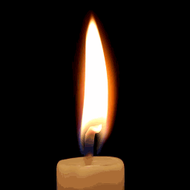
Lighting the Christ Candle

Slide 8
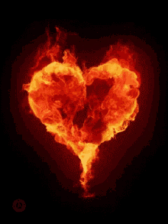
The Lord Be With You
And, Also With You

Slide 9
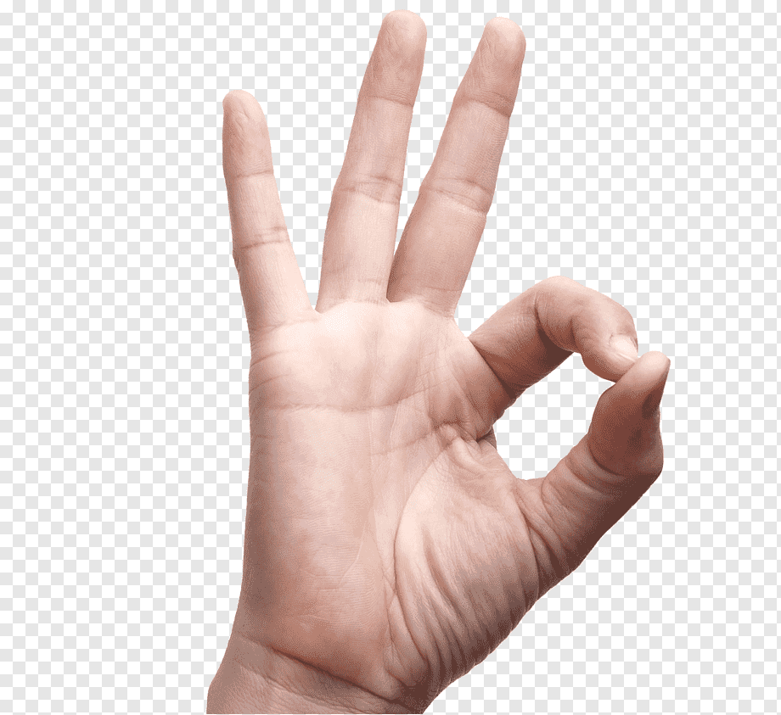
Sign of Peace

Slide 11
Psalm 138
1 I will praise You,
O LORD, with all my heart; before the "gods"
I will sing Your praise.

Slide 12
2 I will bow down
toward Your Holy temple and will praise Your name for Your love and Your faithfulness for You have exalted
above all things Your name and Your word.

Slide 13
3 When I called, You answered me
You made me bold
and stouthearted.
4 May all the kings of the earth
praise You, O LORD, when they hear
the words of Your mouth.

Slide 14
5 May they sing
of the ways of the LORD, for the glory of the LORD is great.
6 Though the LORD is on high,
He looks upon the lowly, but the proud He knows from afar.

Slide 15
7 Though I walk
in the midst of trouble, You preserve my life; You stretch out Your hand against
the anger of my foes, with Your right hand You save me.

Slide 16
8 The LORD will fulfill
His purpose for me; Your love, O LORD, endures forever, do not abandon the works
of Your hands
Amen

Slide 18
Lord, Your almighty Word chaos and darkness heard, and took their flight; hear us, we humbly pray, and, where the Gospel day sheds not its glorious ray, let there be light!
1/4

Slide 19
Saviour, who came to give those who in darkness live healing and sight, heal to the sick in mind, sight to the in-ly blind, now to all humankind, let there be light!
2/4

Slide 20
Spirit of truth and love, life-giving holy Dove, speed forth Your flight! Move on the waters' face bearing the lamp of grace, and, in earth's darkest place, let there be light!
3/4

Slide 21
Holy and blessed Three, glorious Trinity, Wisdom, Love, Might; boundless as ocean's tide, rolling in fullest pride, through the earth far and wide, let there be light!
4/4

Slide 24
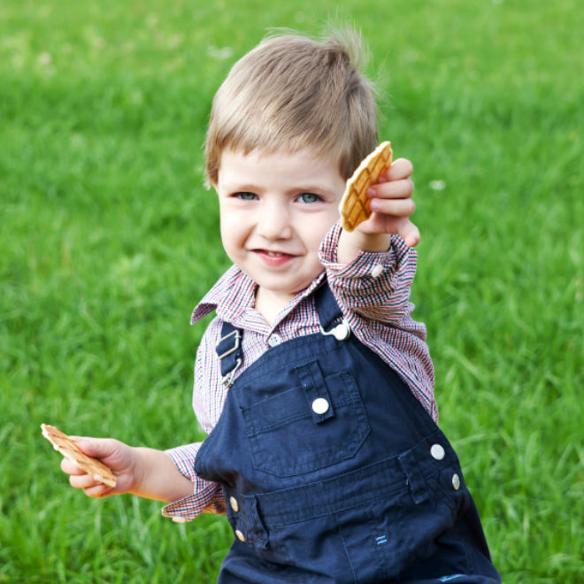

Slide 27
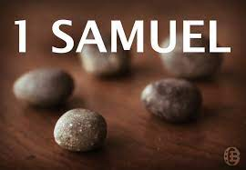

Slide 28
⁴ So all the elders of Israel gathered together and came to Samuel at Ramah. ⁵ They said to him,
“You are old, and your sons do not follow your ways; now appoint a king to lead us, such as all the other nations have.”
⁶ But when they said, “Give us a king to lead us,”
this displeased Samuel; so, he prayed to the Lord.
⁷ And the Lord told him: “Listen to all that the people are saying to you; it is not you they have rejected, but they have rejected me as their king.

Slide 29
⁸ As they have done from the day I brought them up out of Egypt until this day, forsaking me and serving other gods, so they are doing to you. ⁹ Now listen to them; but warn them solemnly and let them know
what the king who will reign over them will claim as his rights.” ¹⁰ Samuel told all the words of the Lord to the people who were asking him for a king.
¹¹ He said, “This is what the king who will reign over you will claim as his rights: He will take your sons and make them serve with his chariots and horses, and they will run in front of his chariots.

Slide 30
¹⁵ He will take a tenth of your grain and of your vintage and give it to his officials and attendants. ¹⁶ Your male and female servants and the best of your cattle and donkeys he will take for his own use. ¹⁷ He will take a tenth of your flocks, and you yourselves will become his slaves.
¹⁸ When that day comes, you will cry out for relief from the king you have chosen, but the Lord will not answer you in that day.”

Slide 31
¹⁹ But the people refused to listen to Samuel.
“No!” they said. “We want a king over us.
²⁰ Then we will be like all the other nations, with a king to lead us and to go out before us and fight our battles.”

Slide 32
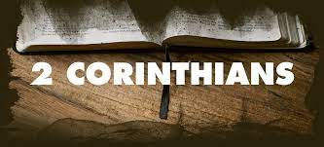

Slide 33
¹³ It is written: “I believed; therefore. I have spoken.”
Since we have that same spirit of faith, we also believe and therefore speak, ¹⁴ because we know that the one who raised the Lord Jesus from the dead will also raise us with Jesus and present us with you to himself. ¹⁵ All this is for your benefit, so that the grace that is reaching more and more people may cause thanksgiving to overflow to the glory of God.

Slide 34
¹⁶ Therefore we do not lose heart. Though outwardly we are wasting away, yet inwardly we are being renewed day by day. ¹⁷ For our light and momentary troubles are achieving for us an eternal glory that far outweighs them all. ¹⁸ So we fix our eyes not on what is seen, but on what is unseen, since what is seen is temporary, but what is unseen is eternal.

Slide 35
Awaiting the New Body
5 For we know that if the earthly tent we live in is destroyed, we have a building from God, an eternal house in heaven, not built by human hands.

Slide 37
Have faith in God, my heart,
Trust and be unafraid;
God will fulfill in every part
Each promise He has made.
1/4

Slide 38
Have faith in God, my mind,
Though oft your light burns low;
God's mercy holds a wiser plan
Than you can fully know.
2/4

Slide 39
Have faith in God, my soul,
His cross for ever stands;
and neither life nor death can pluck
His children from His hands.
3/4

Slide 40
Lord Jesus, make me whole,
Grant me no resting place
Until I rest, heart, mind and soul,
The captive of Your grace.
4/4

Slide 41
¹³ It is written: “I believed; therefore I have spoken, by having faith I can speak, we can all speak and should speak. ” Since WE HAVE THAT SAME SPIRIT OF FAITH, why should we be afraid to share our faith with each-other, we also believe and therefore speak, ¹⁴ BECAUSE we, in this case the Corinthians, know that the one who raised the Lord Jesus from the dead will also raise us with Jesus and present us with you to himself.

Slide 42
¹⁵ All this is for your benefit, so that the grace that is reaching more and more people may cause thanksgiving to overflow to the glory of God, as we discover what grace is, then we can assist others to also experience grace by our story.
¹⁶ Therefore we do not lose heart. Though OUTWARDLY we are WASTING AWAY, yet INWARDLY we are being RENEWED day by day. Our attitude to this can be a pathway to others who struggle with life and pain and disability.

Slide 43
Paul contrasts the temporary nature of his afflictions, which he characterizes as light, with the eternal nature of the exceeding glory that he has begun to experience–and which he expects to continue experiencing through this life and the life to come.
Don’t miss the play on words between “light” (afflictions) and “weight” (glory).
Paul sees his current afflictions as weighing nothing compared with the weight of the glory that he anticipates enjoying in eternity.

Slide 44
¹⁷ For our light and momentary troubles, seemingly weightless, are achieving for us an eternal glory that far outweighs them all. ¹⁸ So we fix our eyes not on what is seen, but on what is unseen, since what is seen is temporary, but what is unseen is eternal. For the young, what they see is present tense, for older people what they see has more “past / passed tense”. Heb 11:1.

Slide 45
Awaiting the New Body
5 For we know that if the earthly tent, tabernacle,
we live in is destroyed, we have a building from God, an eternal house in heaven, not built by human hands.

Slide 49
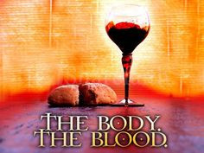
DO THIS IN REMEMBRANCE OF ME.

Slide 50
Holy, holy, holy Lord,
God of power and might,
Heaven and earth
are full of your glory.
Hosanna in the highest.

Slide 51
Blessed is He
who comes in the name of the Lord.
Hosanna in the highest.

Slide 55
Our Father in heaven,
hallowed be Your name,
Your kingdom come,
Your will be done
On earth as in heaven.
Give us today our daily bread.

Slide 56
And forgive us our sins,
As we forgive those
who sin against us.
Save us from the time of trial,
And deliver us from evil.
For the kingdom, the power
and the glory are Yours,
Now and forever. Amen.

Slide 57
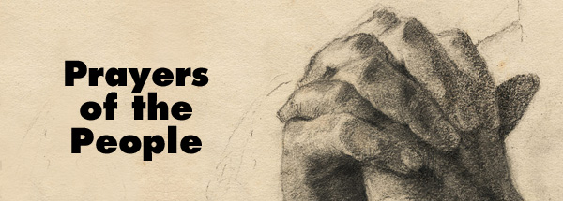

Slide 59
Lord Jesus, joy of loving hearts! True fount of life, our lives sustain
From any bliss that earth imparts We turn unfilled to You again.
1/5

Slide 60
Your truth unchanged has ever stood You save all those who on You call; to those yet seeking You are good; to those who find you, all in all.
2/5

Slide 61
We taste You, Lord, the living Bread, and long to feast upon You still; we drink of You, the fountainhead, and thirst our souls from You to fill.
3/5

Slide 62
For You, our restless spirits yearn Whatever comes, until the last, Glad when Your presence we discern, Blest, when our faith Can hold You fast.
4/5

Slide 63
For ever Jesus, with us stay; Make all our moments calm and bright; Chase the dark night of sin away, Shed on this world Your holy light.
5/5
Bernard of Clairvaux 1091-1153

Slide 65
Good morning
Have a great week

